Slide 1
CLASS 3 – 11.9.2021
Business Operations Revenue Drivers III –
Sponsorship Analytics
Breaks: 5:30pm (5 mins) | 6:05pm (10 mins)
Assignment #2 – Due Nov. 14 {Group}
Guest Speaker: Mauricio Fischmann, Director, Business Intelligence & Analytics, United States Tennis Association (USTA)

Slide 2
Course overview
Forecast attendance for an MLB team
Make dynamic pricing recommendations for an NBA team
Create an opening day MLB line-up
Recommend MLS players for re-entry draft
Use Tableau

Slide 3
Today’s class
Sports Business trends from the past week
Review Assignment 1
Discuss Assignment 2 – due Sunday (11:59pm ET)
Corporate Partnerships 101
Guest Speaker – US Open/USTA

Slide 4
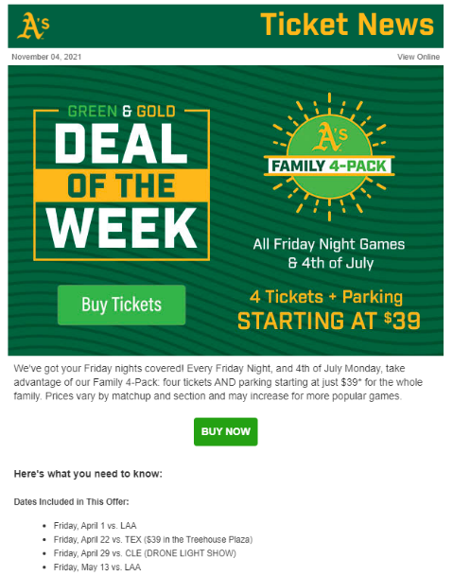
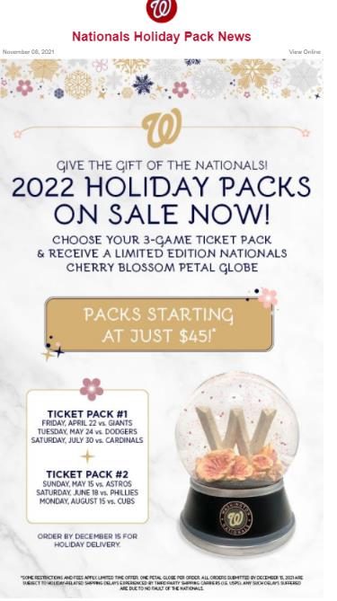

Slide 5
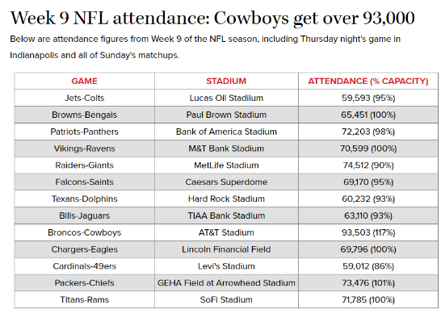
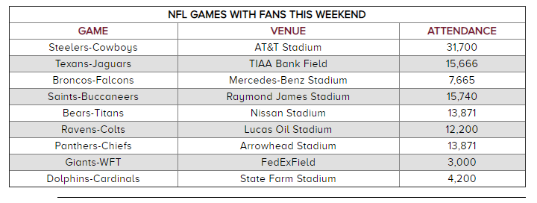

Slide 6
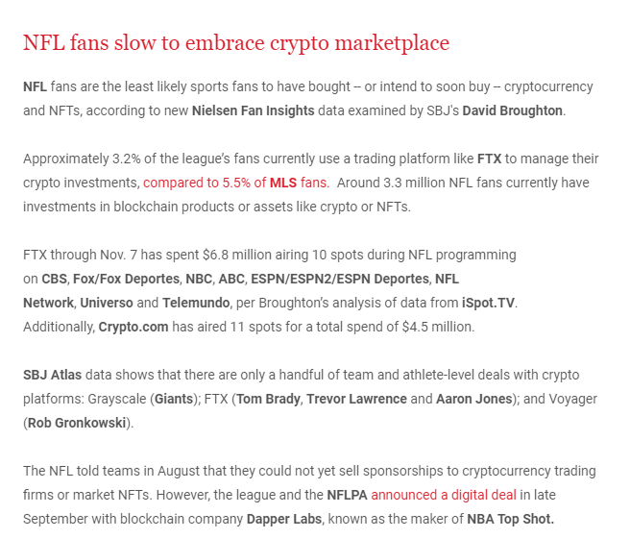
Notes:
SBJ Unpacks – 11.9.2021

Slide 7
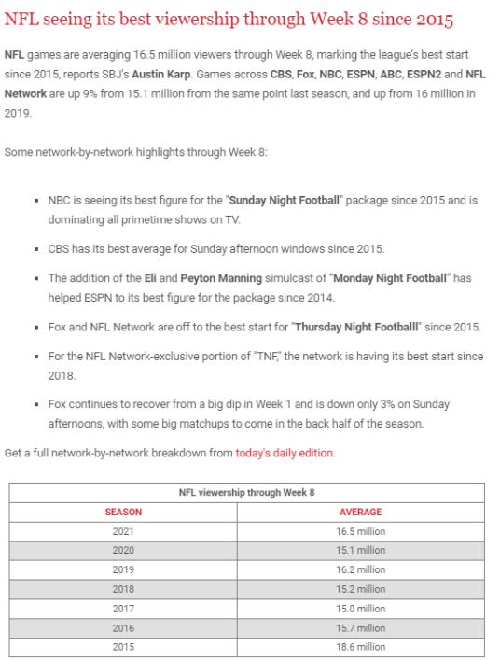

Slide 8
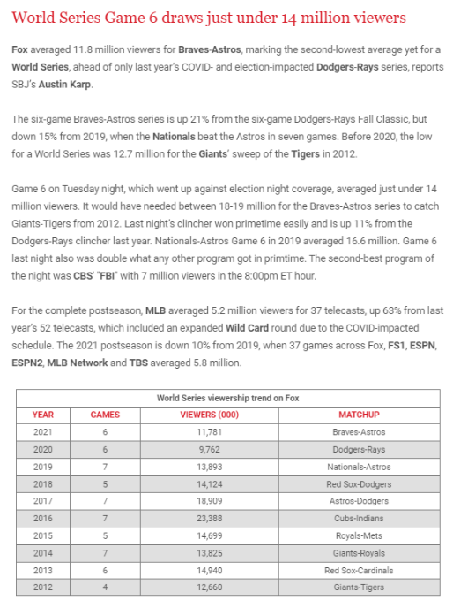

Slide 9
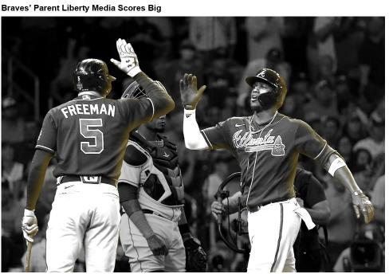
Liberty Media, the parent company of SiriusXM, Formula One Group, and the Braves Group, reported third-quarter earnings Thursday — two days after the Atlanta Braves won their first World Series title since 1995.
The MLB team brought in $234 million in revenue — more than double the $110 million the division brought in last year.
The 113% increase is largely attributed to renewed full-capacity attendance at Truist Park, after no fans were allowed last season. Baseball revenue, which includes ballpark operations, local broadcasting rights, and shared MLB revenue streams, increased 118% to $222 million.
The team is second in the league for regular-season attendance at 2.3 million, an average of 29,490 per home game. The ​​Los Angeles Dodgers’ 2.8 million led MLB.
Formula 1’s revenue grew 10% year-over-year to $668 million, despite only having seven races compared to 10 races in the same period last year.
The U.S. Grand Prix had a total attendance of more than 400,000 over its three-day weekend — the largest race in F1 history.
F1 signed a 10-year deal with Qatar for a permanent spot on the championship calendar starting in 2023.
SiriusXM, which includes programs that cover fantasy sports, NASCAR, the NFL, MLB, and the PGA Tour, saw revenue jump 9% year-over-year to $2.2 billion. Liberty Media owns 78.1% of SiriusXM.

Slide 10
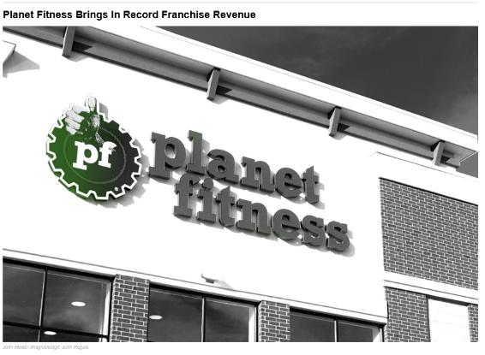
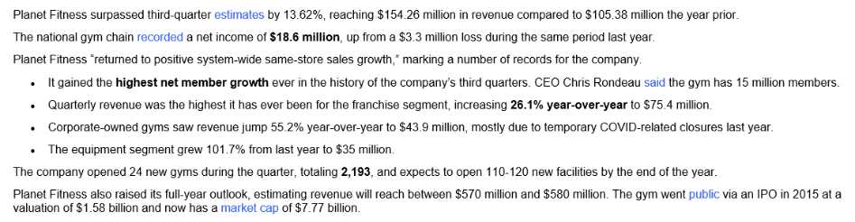

Slide 11
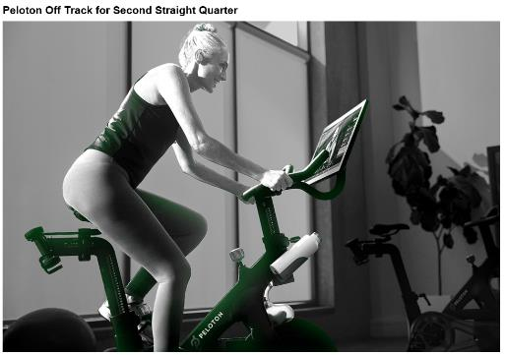
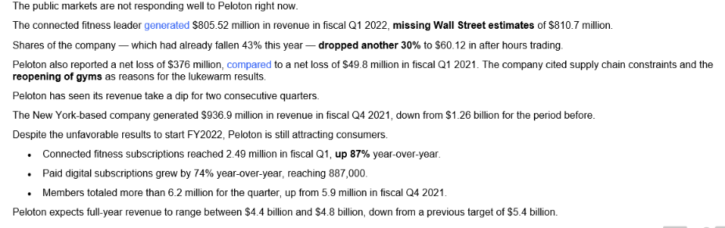
Notes:
Cost: 15 pounds/$20 per game

Slide 12
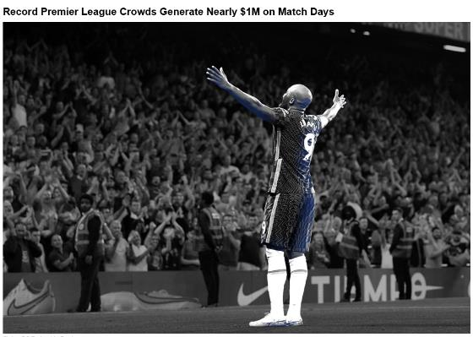
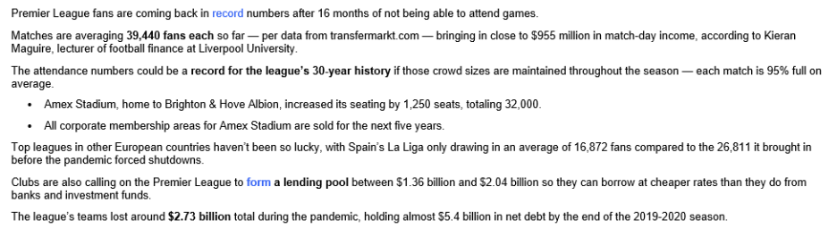
Notes:
Cost: 15 pounds/$20 per game

Slide 13
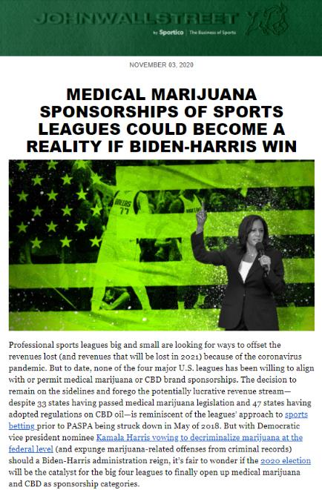

Slide 14
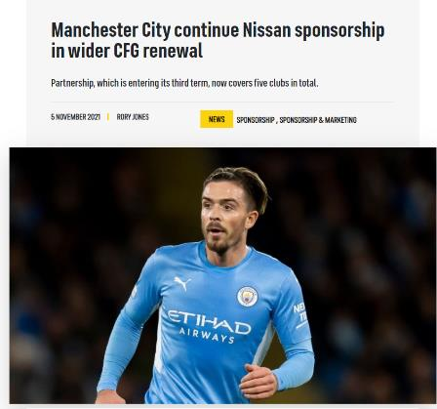
Nissan became CFG’s first multi-club partner in 2014
Manchester City manager Pep Guardiola has been Nissan ambassador since 2019
New deal also includes Chinese club Sichuan Jiuniu FC
City Football Group (CFG), the owner of Premier League champions Manchester City, has announced an extension of its global partnership with Japanese car manufacturer Nissan.
Nissan was the first brand to partner with multiple CFG-owned soccer clubs in 2014, when it became the official automative partner of Manchester City, New York City FC and Melbourne City FC.
Since then, the partnership has been expanded to include Spanish outfit Girona FC, with the latest extension also covering Chinese second-tier club Sichuan Jiuniu FC.
The extension means Nissan will continue to benefit from exposure during Manchester City, New York City FC and Melbourne City FC games, as well as at Girona and Sichuan Jiuniu fixtures.
Notes:
https://www.sportspromedia.com/news/man-city-nissan-cfg-sponsorship-extension-pep-guardiola/

Slide 15
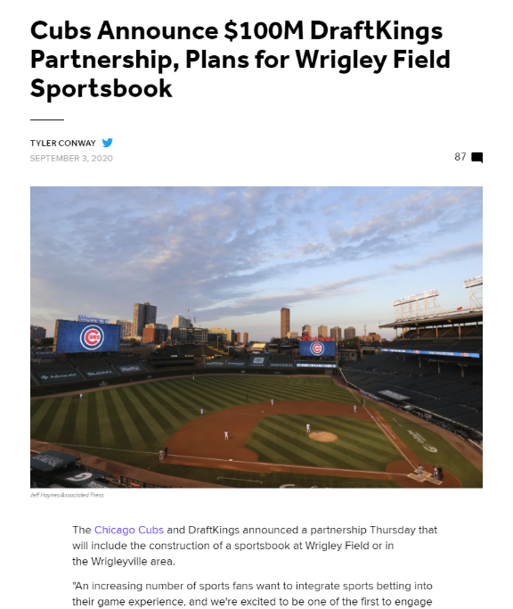
Notes:
https://bleacherreport.com/articles/2907476-cubs-announce-100m-draftkings-partnership-plans-for-wrigley-field-sportsbook

Slide 16
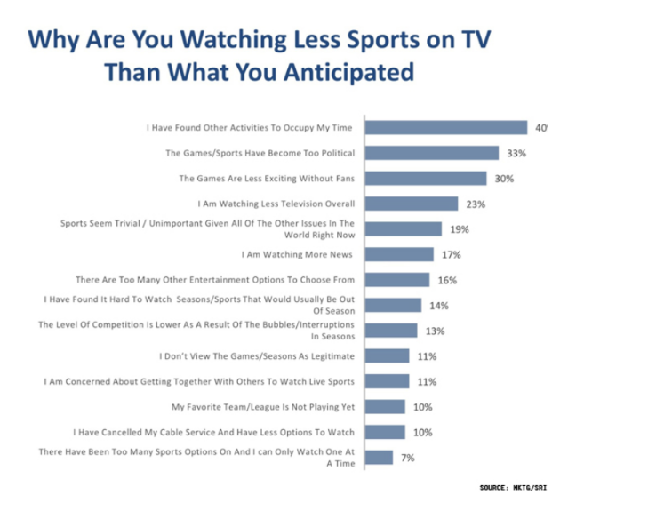
Source: SportsBusinessDaily

Slide 17
Orioles Attendance – Average/Game
Assignment 1
14
20
23
24
21
24
26
20
18
13
19
20
23
26
28
26

Slide 18
Assignment 1 – 2022 O’s Projections

Slide 19
Assignment 1 predictions – last year’s class

Slide 20
Assignment 1 predictions – two years ago

Slide 21
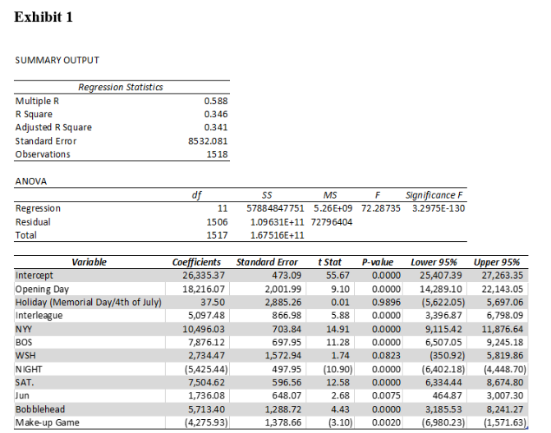
Around the Horn

Slide 22
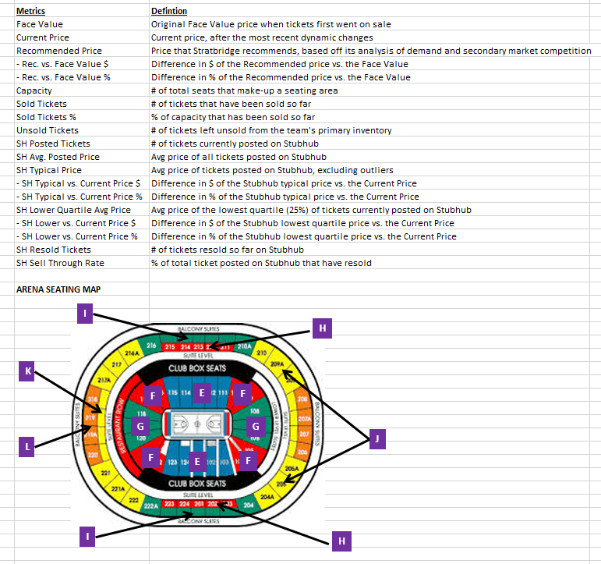
Assignment #2

Slide 23
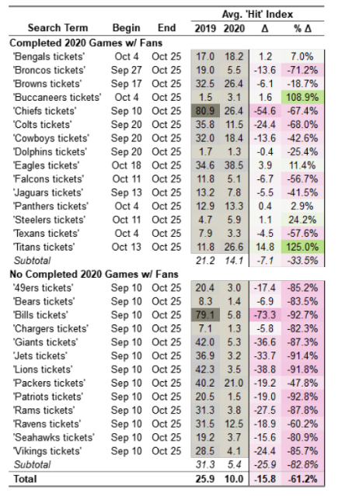
Gauging Fan Return – DemandAnalytics (cont.)
Google Trends returns a 0-100 ‘hit’ value for a given search where every search returns at least one 100 value.
Because this metric is not in absolute terms, we generate a “ ‘Hit’ index”. This index is normalized such that a 100 indicates the average searches for an “events” benchmark within that DMA since 2004 (the beginning of Google Trends data). This normalization allows for apples-to-apples analysis:
1. Over time — many years at a granular (weekly) level of detail.
2. Across markets — markets over differing timeframes.
All Google Trends data are current through Sunday 10/25/20. Washington Football Team and Las Vegas
Raiders are excluded due to recent name and location changes.

Slide 24
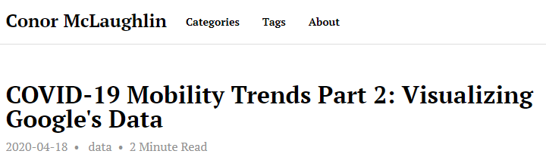
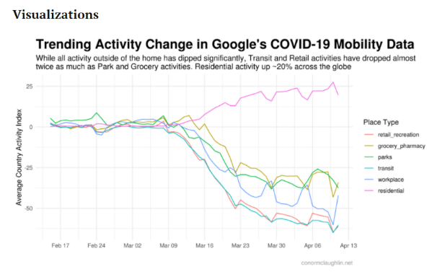
Gauging Fan Return – Google Mobility Trends
Notes:
http://conormclaughlin.net/2020/04/covid-19-mobility-trends-part-2-visualizing-googles-data/

Slide 25

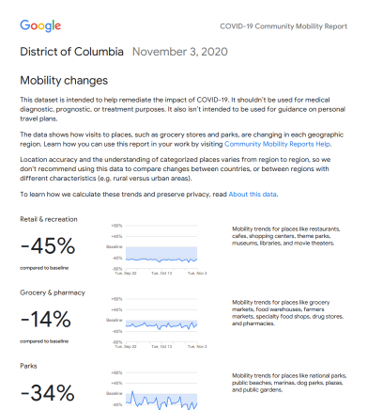
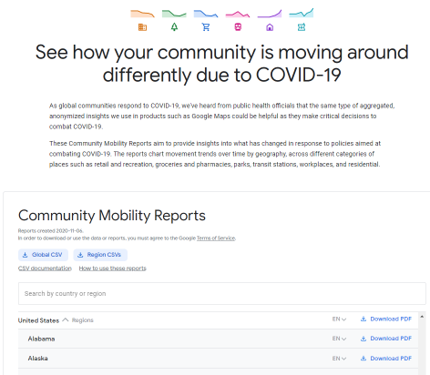
Gauging Fan Return – Google Mobility Trends
Notes:
https://www.google.com/covid19/mobility/
https://www.gstatic.com/covid19/mobility/2020-11-03_US_District_of_Columbia_Mobility_Report_en.pdf
https://www.gstatic.com/covid19/mobility/2020-11-03_US_California_Mobility_Report_en.pdf

Slide 26
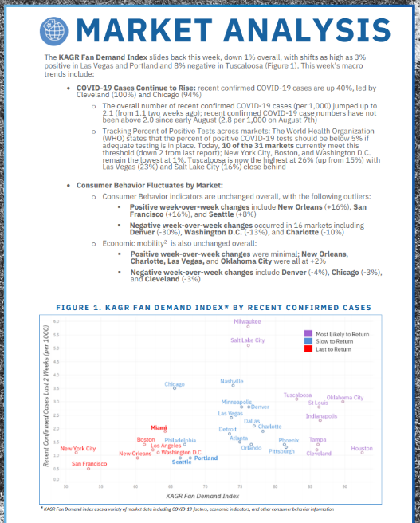

Gauging Fan Return – KAGR
KAGR – Future of Live Events & Sports Weekly Series: 30 total variables. Econ indicators such as consumer behavior, mobility (Ninth Decimal – look at movement by cell phone signal tracking)
Notes:
https://www.kagr.com/wp-content/uploads/KAGRFutureofSports_RegularUpdate_Issue12-FINAL.pdf

Slide 27
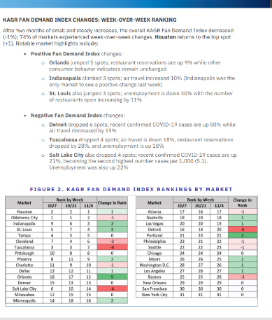
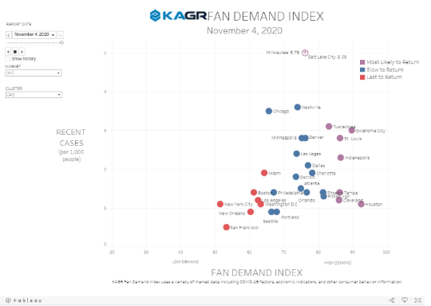
Gauging Fan Return – KAGR (cont.)
Notes:
https://www.kagr.com/kagr-fan-demand-index-by-recent-confirmed-cases/
Spend 4-5 minutes, look at KAGRs visualization (report, markets, clusters) – what insights do you draw?

Slide 28
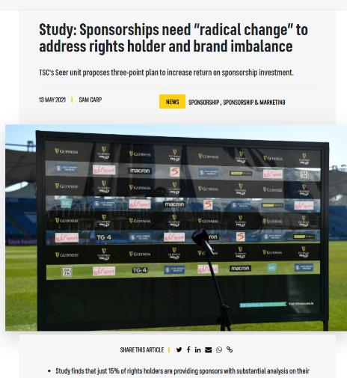
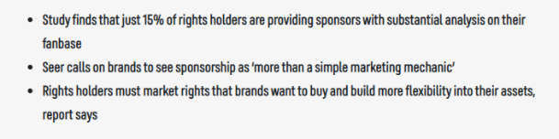
Sponsorships – gauging ROI
Notes:
https://www.sportspromedia.com/news/sports-sponsorship-industry-reset-rights-assets-brand-values-tsc-seer-study/

Slide 29
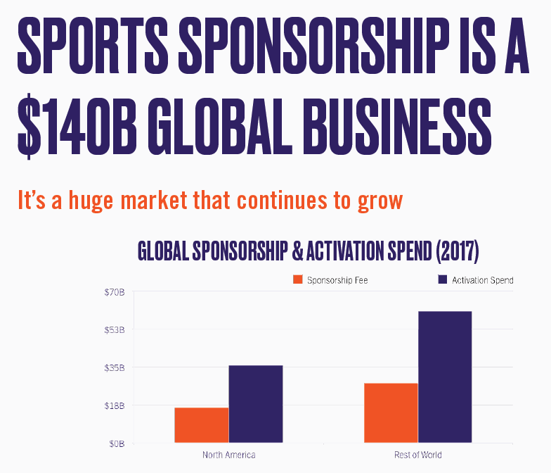
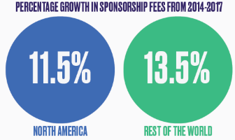
Sponsorship: What is it | Role of analytics

Slide 30
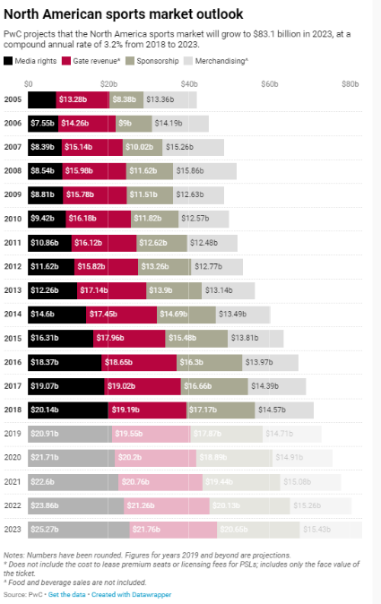
SPONSORSHIP REVENUE TO GENERATE LARGEST CATEGORY GROWTH RATE IN THE SPORTS INDUSTRY
Notes:
https://www.datawrapper.de/_/W8ltp/

Slide 31
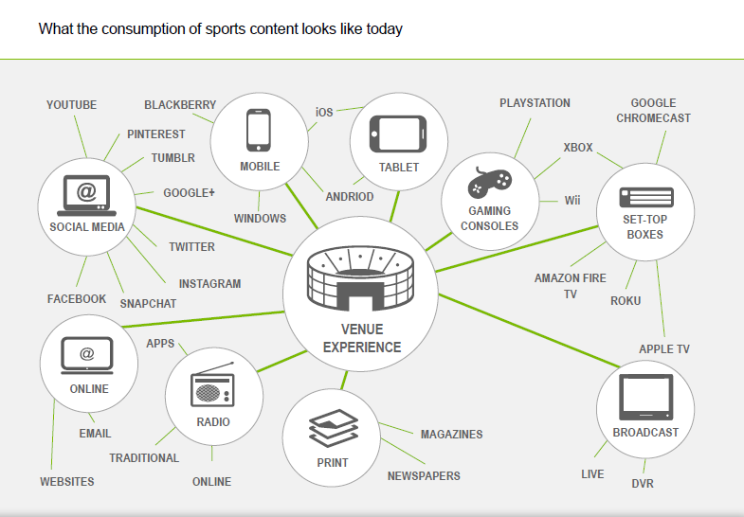

Slide 32
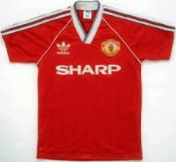
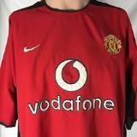
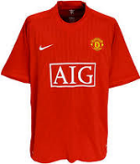
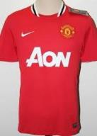
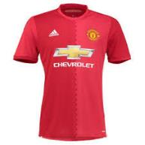
Sponsorship 101 (Promotional Licensing)
Partnership Marketing
Acquisition of rights to affiliate or directly associate with a product or event for the purpose of deriving benefits related to that affiliation or association
Usually involves two or more elements of the marketing mix
Provides sponsor with:
Association
Recognition value
Exposure
Opportunities to help them achieve their marketing objectives
End goal: Inform and persuade the customer and influence the purchase decision

Slide 33


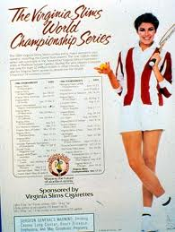

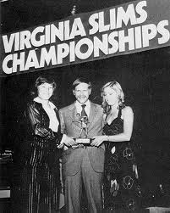
Sponsorship - history
1971: Cigarette ads banned from TV advertising. Tobacco companies forced to redirect massive ad budgets to sports sponsorships
1970s
Correct inequality in prize money between men & women
Precursor to WTA
Other sponsors:
Nextel Cup: ’03-’07
Sprint Cup: ‘07-’16
Monster Energy: ‘17-’19

Slide 34
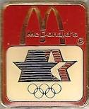

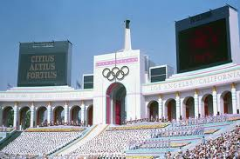
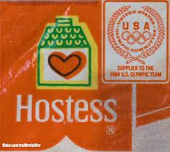
1984 Olympics – Birth of the modern sponsorship Olympiad
The Olympic Partner (TOP) Program
30 official sponsors
First games to turn a profit ($225M) since 1932
First privately organized games
Category exclusivity – less clutter

Slide 35
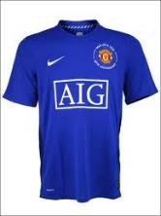
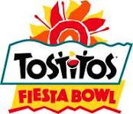

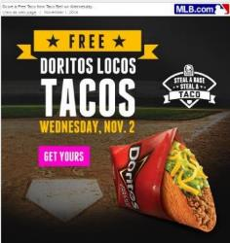
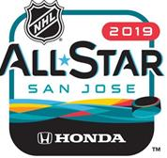
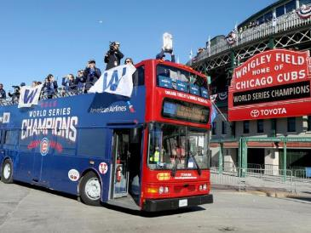
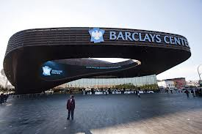
Activation elements
Use of logo, name, trademark
Exclusive association, category exclusivity
NFL: 454 partners (‘94) to 250
Entitlement to an event or facility, hospitality
Event/facility sponsorship
Promotional activities, contests, ad campaigns

Slide 36




MLB – TARP ACTIVATION
Notes:
http://www.sportsbusinessdaily.com/Daily/Issues/2017/06/07/Marketing-and-Sponsorship/Nationals.aspx

Slide 37




Asset management
Notes:
https://www.youtube.com/watch?v=Bvi9zpHlrvg
https://www.youtube.com/watch?v=NeUzBbW2QRE

Slide 38



NBA – JERSEY PATCH ACTIVATION
Notes:
http://www.nba.com/2016/news/05/16/philadelphia-76ers-first-team-to-get-advertiser-on-jersey-in-nba-history/

Slide 39

NBA – JERSEY PATCH ACTIVATION
Notes:
http://www.sportsbusinessdaily.com/Daily/Issues/2016/10/10/Marketing-and-Sponsorship/Kings.aspx

Slide 40

NBA – JERSEY PATCH ACTIVATION
Notes:
http://www.sportsbusinessdaily.com/Daily/Issues/2017/10/25/Marketing-and-Sponsorship/Pelicans-Jersey-Patch.aspx?ana=SBD%20
http://www.sportsbusinessdaily.com/Daily/Issues/2017/11/13/Marketing-and-Sponsorship/Hornets-Patch.aspx?ana=SBD%20Email

Slide 41

NBA – JERSEY PATCH ACTIVATION 2021-2022 SEASON

Slide 42
NBA Jersey Patches – 2021-2022
Many NBA teams are looking to jersey patch deals to help offset financial losses caused by the coronavirus pandemic.
Patch Money: The NBA piloted jersey patches during the 2017-2018 season and made them permanent in 2019. To date, the program has generated more than $150 million in revenue.
Patch deals have ranged in average value from $7 million to $10 million per season. The Golden State Warriors’ deal with Rakuten is reportedly the league’s most valuable at $20 million annually.
One expert estimates that the NBA could see a 20% decline in its patch sponsorship business due to COVID-19 spending cutbacks and lower television ratings — an unwelcome prospect as the league looks to recover from the financial hit it has taken in 2020.
The NBA missed out on an estimated $1.5 billion in revenue after finishing last season in the Orlando Bubble, which cost about $170 million.
Reducing this season’s schedule from 82 games to 72 is expected to cost each team an average of $13.5 million in revenue from fans.
The Brooklyn Nets and Los Angeles Clippers are among the four teams entering the upcoming season with new jersey patch partners, partnering with Motorola and Honey, respectively.
Three teams don’t have a jersey partner to start the season after deals expired: Milwaukee, Minnesota and Sacramento.
The league recently approved sponsors on practice and shootaround jerseys as another way for teams to generate revenue.

Slide 43

Notes:
https://www.nba.com/wizards/monumental-sports-entertainment-announces-geico-first-ever-jersey-patch-partner

Slide 44

NBA – JERSEY PATCH ACTIVATION
Notes:
http://www.sportsbusinessdaily.com/Daily/Issues/2017/09/13/Marketing-and-Sponsorship/Warriors

Slide 45

NBA – JERSEY PATCH ACTIVATION
RAKUTEN ALREADY IS WINNING WITH THE WARRIORS
Comparing 58 posts per account from date of announcement (9/12/17 to 10/18/17)
 | GSW FB | Rakuten FB
Overall Value ($) | $61,400 | $734
# Impressions | 19.6M | 3,600
Engagement Rate | 0.15% | 0.004%
Sentiment Score | 12.16% | 27.1%
Source: BlinkFire Analytics

Slide 46


NBA – TRAINING CENTER NAMING RIGHTS
Notes:
http://www.sportsbusinessdaily.com/Journal/Issues/2016/09/19/Franchises/Sixers-practice-facility.aspx

Slide 47

NBA Sponsorship Revenue
Notes:
https://www.sponsorship.com/About/Sponsorship-Blogs/Sponsorship-Blog/May-2019/NBA-Sponsorship-Revenue-Grows-by-8-0--for-2018-19.aspx

Slide 48


NBA Sponsorship Revenue (cont.)
Notes:
https://www.sponsorship.com/About/Sponsorship-Blogs/Sponsorship-Blog/May-2019/NBA-Sponsorship-Revenue-Grows-by-8-0--for-2018-19.aspx

Slide 49

NBA: 2020-2021
Changes for next season
Previously off-limit baseline apron areas near the baskets as new high-profile sponsorship inventory.
Three global sponsorships as part of its International Team Marketing Program that previously was limited to two global deals.
The league also is easing restrictions on hard alcohol, casino and sports betting team sponsorships that would allow for greater TV visible in-arena signage in those categories.
In addition, the NBA will now let teams create nongame live digital content for second-screen use to complement game broadcasts. For example, a team could stream its in-arena halftime shows live during games on their team website or team app to complement game programming. Other ideas include providing live nongame digital content during quarter game breaks such as interviews with former players. The hope is that teams could sell sponsorships for the additional programming to drive more revenue.

Slide 50

Sponsorship in Canada
Source: SponsorshipX Virtual Series: 14th Annual Canadian Sponsorship Landscape Study – 10.29.2020

Slide 51

Sponsorship in Canada (cont.) – Objectives to achieve ROO/ROI
Source: SponsorshipX Virtual Series: 14th Annual Canadian Sponsorship Landscape Study – 10.29.2020

Slide 52

Sponsorship in Canada (cont.)
Source: SponsorshipX Virtual Series: 14th Annual Canadian Sponsorship Landscape Study – 10.29.2020

Slide 53

Sponsorship in Canada (cont.)
Source: SponsorshipX Virtual Series: 14th Annual Canadian Sponsorship Landscape Study – 10.29.2020

Slide 54

Sponsorship in Canada (cont.)
Source: SponsorshipX Virtual Series: 14th Annual Canadian Sponsorship Landscape Study – 10.29.2020

Slide 55



Deal valuation
Value of Sponsorship deal depends on many factors:
* Hard assets (in-park signage, naming rights)
* Soft assets (promos, campaigns)
* Category exclusivity
* Industry competition
* Value of past deals
* Activation
* Length of deal term
* Market size (NY/LA vs. DC)
* Economy/Financial health
Notes:
http://www.sportsbusinessdaily.com/Daily/Issues/2012/07/31/Marketing-and-Sponsorship/ManU-GM.aspx?hl=gm%20manchester%20united&sc=0

Slide 56



Notes:
http://www.totalsportek.com/football/premier-league-shirt-sponsorship-deals/

Slide 57



EPL – JERSEY SLEEVE ACTIVATION
Notes:
http://www.sportsbusinessdaily.com/Daily/Closing-Bell/2017/08/09/Liverpool.aspx
http://www.sportsbusinessdaily.com/Daily/Issues/2016/11/15/Marketing-and-Sponsorship/EPL-Sleeves.aspx?hl=EPL%20SLEEVE&sc=0

Slide 58



STADIUM/ARENA NAMING RIGHTS
$11M/yr
Notes:
https://www.dallasnews.com/business/sports-business/2017/08/24/rangers-announce-new-deal-look-richest-us-stadium-naming-rights-partnerships

Slide 59


$30M/Year
https://www.cnbc.com/2019/09/15/sofi-naming-rights-for-los-angeles-stadium-for-the-rams-and-chargers.html
Notes:
https://www.cnbc.com/2019/09/15/sofi-naming-rights-for-los-angeles-stadium-for-the-rams-and-chargers.html

Slide 60




STADIUM/ARENA NAMING RIGHTS
Notes:
http://www.sportsbusinessdaily.com/Journal/Issues/2017/10/16/Marketing-and-Sponsorship/Monumental.aspx?utm_campaign=SportsBusiness+Saturday10%2f21%2f2017&utm_source=JournalLink4&utm_medium=email

Slide 61

NFL – MICROSOFT ACTIVATION
The multifaceted sponsorship was not cheap, and it is one reason the N.F.L. took in $1.1 billion in sponsorship revenue last year. Microsoft will reportedly pay the N.F.L. $400 million over the five-year life of the deal, figures that the company and the league would not confirm.
Notes:
http://www.nytimes.com/2014/10/16/sports/football/sideline-tablets-help-microsoft-squeeze-into-the-nfl-picture.html?ref=sports&_r=0

Slide 62


NFL – MICROSOFT ACTIVATION
Notes:
http://www.sportsbusinessdaily.com/Daily/Issues/2016/10/20/Marketing-and-Sponsorship/Microsoft-NFL.aspx?hl=microsoft%20surface&sc=0
http://www.sportsbusinessdaily.com/Daily/Issues/2016/10/19/Marketing-and-Sponsorship/Belichick.aspx?hl=microsoft%20surface&sc=0

Slide 63



MEASURING FAN LOYALTY

Slide 64


Determining ROI/ROO - Social
Notes:
https://www.blinkfire.com/landing

Slide 65

Notes:
https://www.blinkfire.com/landing

Slide 66

NBA Finals – YouTube TV

Slide 67

NBA Finals – YouTube TV (cont.)

Slide 68




Slide 69



Notes:
https://www.sportsbusinessdaily.com/Daily/Issues/2020/11/09/Franchises/Gritty.aspx

Slide 70


Determining ROI/ROO -TV Only

Slide 71


Slide 72


Slide 73






Nationals Top 10 Sponsors
Top 10 Brands by QI Media Value
73

Slide 74


Slide 75





ESPN SportsCenter Share of Voice
The following table displays the share of voice and duration for Nationals coverage on ESPN SportsCenter coverage from March 2012 through June 2012. The Nationals currently rank 4th in total SportsCenter MLB coverage.
SportsCenter share of voice is calculated as the total news time dedicated to each team/league on SportsCenter. Based on three daily broadcasts 1800, 2300, 0200.
 | March (seconds) | April (seconds) | May (seconds) | June (seconds) | Total
 | 215 | 1,458 | 5,614 | 3,285 | 10,572
 | 13,558 | 58,606 | 73,635 | 51,676 | 197,475
Nationals Share of Voice within MLB SC Coverage | 1.6% | 2.5% | 7.6% | 6.4% | 4.53%
75

Slide 76

ESPN SportsCenter Share of Voice
MLB SportsCenter Coverage by Team
Nationals – ESPN SportsCenter Share of Voice
SportsCenter coverage for the Nationals peaked during May coverage when the Nationals received 7.6% of all MLB coverage on SportsCenter.
The Nationals received the most SportsCenter coverage in May because they were tops the NL East, and Bryce Harper was called up and started playing full time.
76

Slide 77

Determining ROI/ROO – In-venue + Digital (Web, Email, Social)
Notes:
http://www.blocksixanalytics.com/

Slide 78

BLOCKSIX ANALYTICS

